Slide 1
CTE, Temp Tables, Subqueries
Common Table Expressions
Temp Tables (global, local), Table Types
Table Variables
Subqueries: Correlated, Uncorrelated
Operators: Exists, Having, IN

Slide 2
CTE: Common Table Expressions
A method to pass a select result (inner query) to another select (outer query).
Compares to: Temp Table or subquery/nested query
Key word “With”
Syntax practice example:
With CTE_Row(ROWNO) as
(
SELECT ROW_NUMBER() OVER(ORDER BY name ASC) AS ROWNO
FROM sys.databases
WHERE database_id <= 10
)
SELECT * FROM CTE_Row

Slide 3
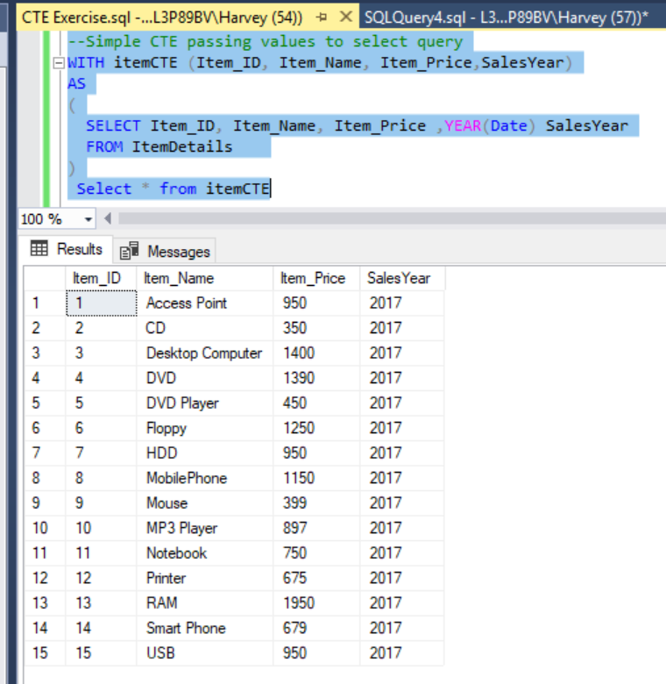
Example from SQLShack
CTE
https://www.sqlshack.com/sql-server-common-table-expressions-cte/

Slide 4
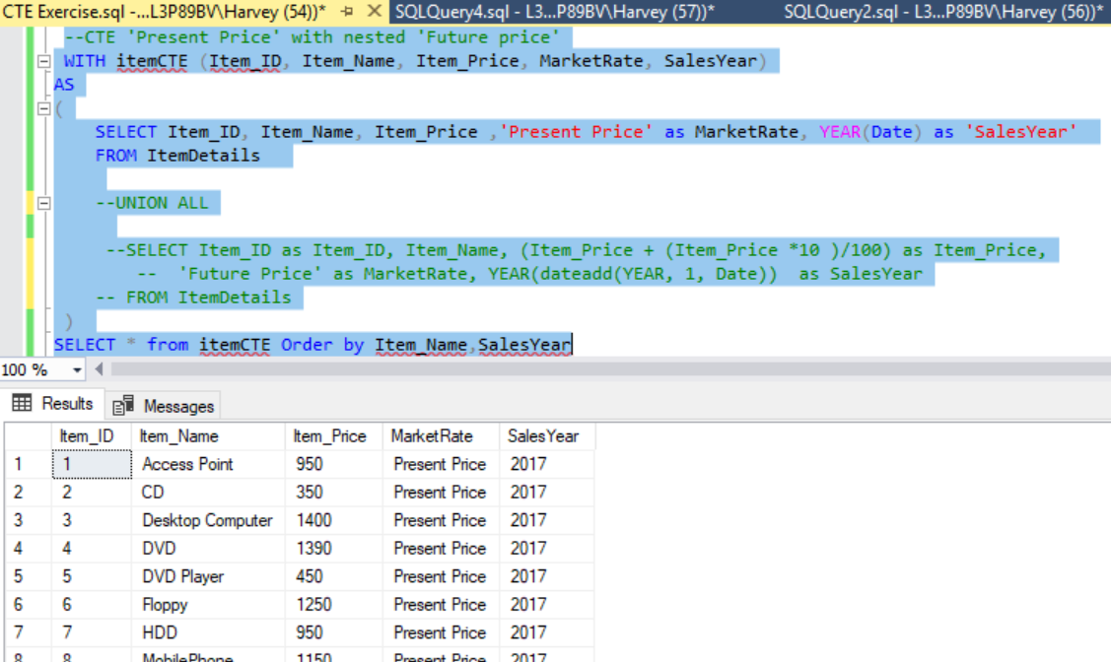
CTE manipulation to add ‘Present Price’ value
Inner select
Outer select

Slide 5
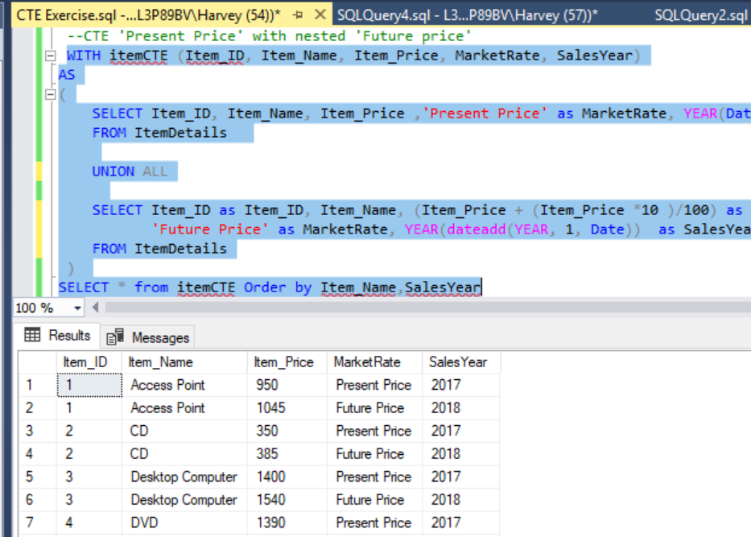
CTE more complex manipulation
Notice use of Union ALL to append Select statements within CTE

Slide 6
Create a View using CTE
CREATE VIEW vCTE_item
AS
WITH itemCTE1 AS
(
SELECT Item_ID, Item_Name, Item_Price ,'Present Price' as MarketRate,Date as IDate
FROM ItemDetails
UNION ALL
SELECT Item_ID as Item_ID, Item_Name,(Item_Price + (Item_Price *10 )/100) as Item_Price,
'Future Price' as MarketRate, dateadd(YEAR, 1, Date) as IDate
FROM ItemDetails
)
SELECT Item_ID, Item_Name, Item_Price,MarketRate,year(IDate) as IDate from itemCTE1
CTE
View

Slide 7
CTE with ROW_NUMBER, Partition BY, OVER
https://www.sqlshack.com/overview-of-the-sql-row-number-function/

Slide 8
Example using AdventureWorks2017
create proc DemoRowNUM_PartitionBy_CTE as begin
--Row_Number with Partition by
SELECT top 100 ROW_NUMBER() OVER(PARTITION BY CustomerID, DATEADD(MONTH, DATEDIFF(MONTH, 0, OrderDate), 0) ORDER BY SubTotal DESC) AS 'MonthlyOrders', CustomerID, SalesOrderID, OrderDate, SalesOrderNumber, SubTotal, TotalDue
FROM Sales.SalesOrderHeader;
--compare with no Partition by
SELECT ROW_NUMBER() OVER(ORDER BY CustomerID) AS 'RowNum', CustomerID, SalesOrderID, OrderDate, SalesOrderNumber, SubTotal, TotalDue
FROM Sales.SalesOrderHeader
ORDER BY SalesOrderID;
--compare to CTE passing sub-query result to Select Statement
WITH CTE
AS
(SELECT top 100 ROW_NUMBER () OVER(PARTITION BY customerID, MONTH(OrderDate) ORDER BY SubTotal DESC, TotalDue DESC ) AS 'ROW_NUM',
CustomerID, MONTH(OrderDate) as 'Month', SubTotal, TotalDue, OrderDate
FROM Sales.SalesOrderHeader
)
SELECT * FROM CTE
WHERE ROW_NUM <= 5
Order by CustomerID --'month'
end

Slide 9
Temp Tables and Table Variables vs CTEs
Create table #temptable (local) access inside local session only.
Create table ##temptable (global) access outside local session.
Both type Tables auto drop when session closes.
Temp Tables: are good for storing and manipulating subsets of table rows.
Lasts the duration of the session
Table Variables: for returning table function values.
Back bone of UDFs
CTEs: Passing results within a sub/nested query.

Slide 10
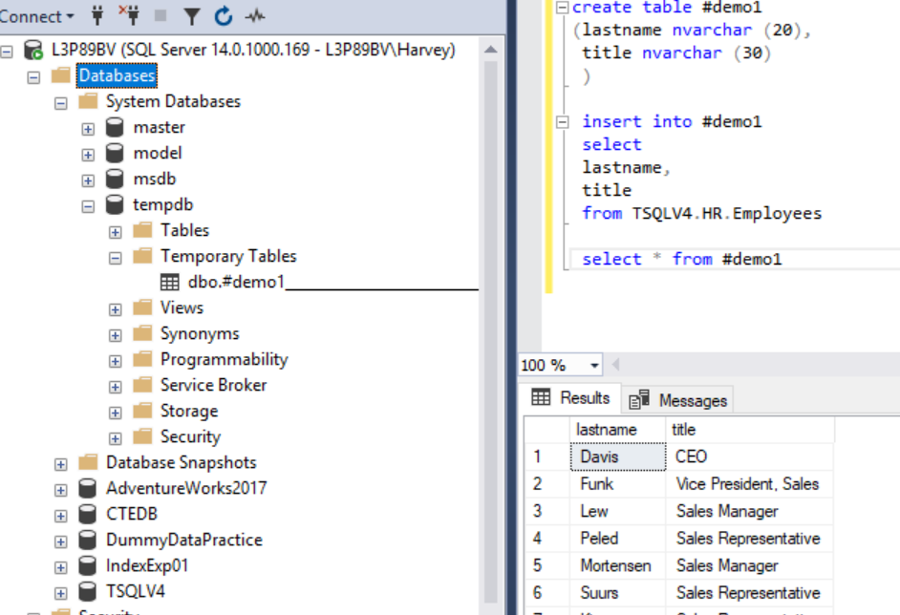
Temp Table Syntax Example
create table #demo1
--create table ##demo1
(lastname nvarchar (20),
title nvarchar (30)
)
insert into #demo1
select
lastname,
title
from TSQLV4.HR.Employees
select * from #demo1
--drop table #demo1

Slide 11
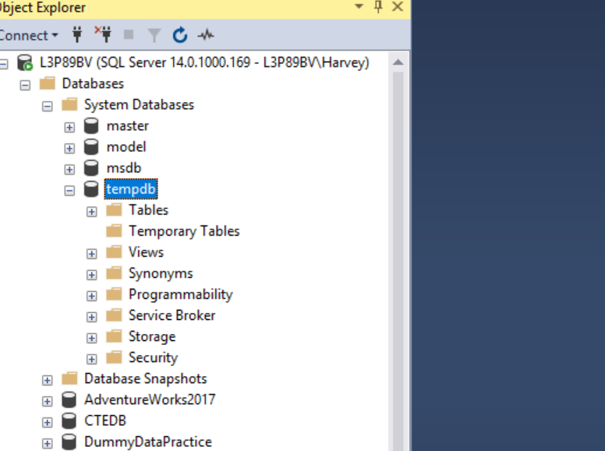
Temp Table will auto drop when close Query Session
This is both good and bad!

Slide 12
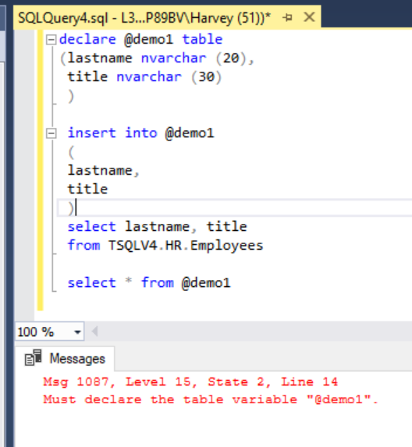
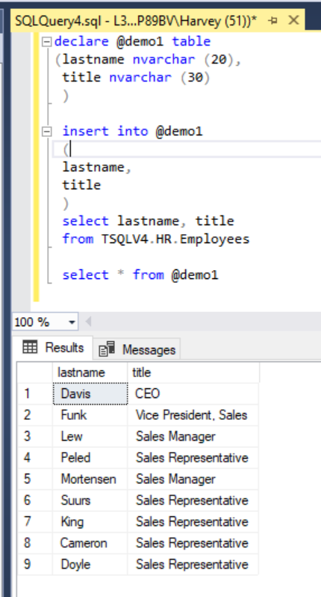
Table Variable Syntax Example
declare @demo1 table
(lastname nvarchar (20),
title nvarchar (30)
)
insert into @demo1
(
lastname,
title
)
select lastname, title
from TSQLV4.HR.Employees
select * from @demo1
Must execute entire code, not in steps

Slide 13
Compare: CTE, Temp Table, Table Variable
create proc DemoCTEandTempTable
as
begin
-- CTE
WITH t (customerid,lastorderdate) AS
(SELECT customerid, max(orderdate) FROM sales.SalesOrderHeader
GROUP BY customerid)
SELECT * FROM sales.salesorderheader soh
JOIN t ON soh.customerid=t.customerid AND soh.orderdate=t.lastorderdate
-- Temp table
CREATE TABLE #temptable (customerid [int] NOT NULL PRIMARY KEY,lastorderdate [datetime] NULL);
INSERT INTO #temptable
SELECT customerid,max(orderdate) lastorderdate FROM sales.SalesOrderHeader
GROUP BY customerid;
SELECT * from sales.salesorderheader soh
JOIN #temptable t ON soh.customerid=t.customerid AND soh.orderdate=t.lastorderdate
--drop table #temptable
-- Table variable
DECLARE @tablevariable TABLE (customerid [int] NOT NULL PRIMARY KEY,lastorderdate [datetime] NULL);
INSERT INTO @tablevariable
SELECT customerid,max(orderdate) lastorderdate FROM sales.SalesOrderHeader
GROUP BY customerid;
SELECT * from sales.salesorderheader soh
JOIN @tablevariable t ON soh.customerid=t.customerid AND soh.orderdate=t.lastorderdate
end
https://www.mssqltips.com/sqlservertip/5118/sql-server-cte-vs-temp-table-vs-table-variable-performance-test/

Slide 14
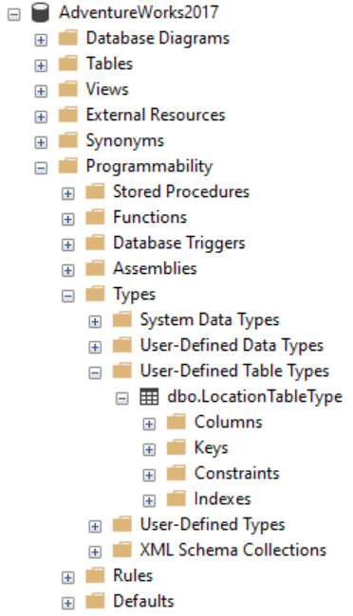
Table Type
Like a template for a Table
You create it,
Then declare any future variable table as that type
/* Create a table type. */
CREATE TYPE LocationTableType AS TABLE
( LocationName VARCHAR(50), CostRate INT );
/* Declare a variable that references the type. */
DECLARE @LocationTVP AS LocationTableType;
/* Add data to the table variable. */
INSERT INTO @LocationTVP (LocationName, CostRate)
SELECT Name, 0.00
FROM AdventureWorks2017.Person.StateProvince;
/*display results */
select * from @LocationTVP

Slide 15
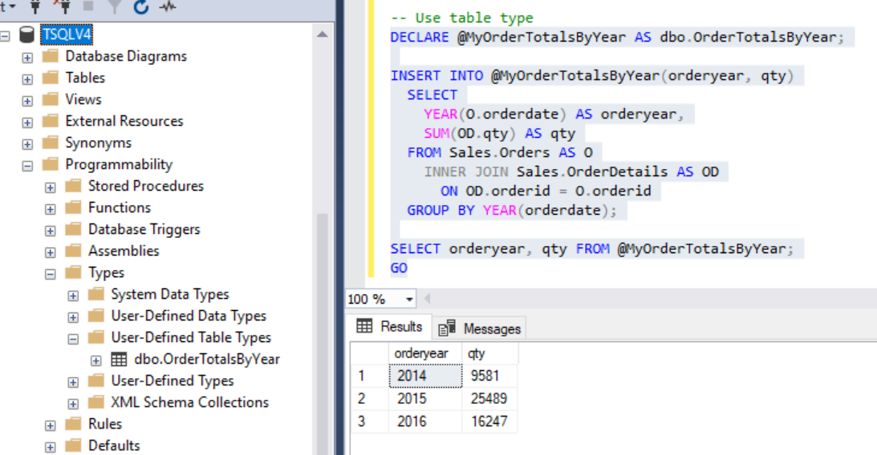
Table Type Use Example

Slide 16
Sub Queries
Correlated: Sub query executes for each row of the outer query (think loop).
Subquery contains a reference to an object defined in the outer query.
Uncorrelated: Processes entire set then passes up result to outer query.
Subquery does not reference to object in outer query.
--uncorrelated subquery
SELECT Name, Description
FROM Product
WHERE Quantity < 2 *
(
SELECT AVG( Quantity )
FROM SalesOrderItem
);
--correlated subquery
SELECT Name, Description
FROM Product
WHERE Quantity < 2 *
(
SELECT AVG( Quantity )
FROM SalesOrderItem
WHERE Product.ID = SalesOrderItem.ID
);

Slide 17
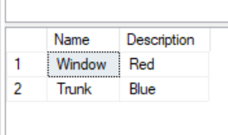
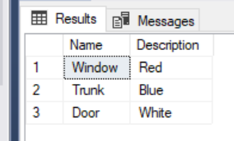
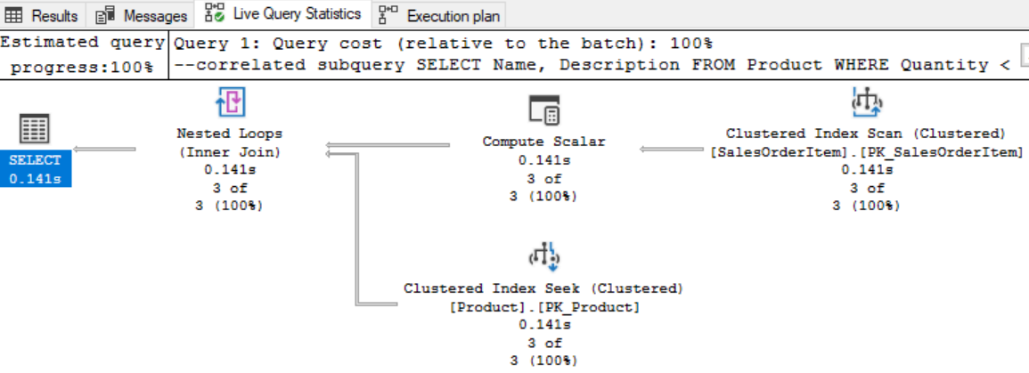
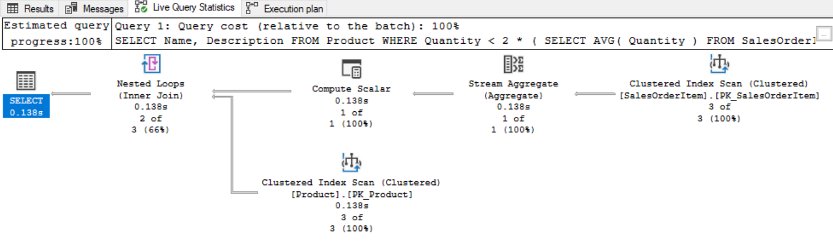
Compare
--correlated subquery
SELECT Name, Description
FROM Product
WHERE Quantity < 2 *
(
SELECT AVG( Quantity )
FROM SalesOrderItem
WHERE Product.ID = SalesOrderItem.ID
);
--uncorrelated subquery
SELECT Name, Description
FROM Product
WHERE Quantity < 2 *
(
SELECT AVG( Quantity )
FROM SalesOrderItem
);

Slide 18
Compare Sub/Nested Queries vs CTE
--Nested Subquery as Derived table
SELECT CustomerId, SalesOrderId, OrderDate, TotalDue, MonthSales.OrderYear, MonthSales.OrderMonth, MonthTotal, YearTotal
FROM (
SELECT CustomerID, SalesOrderID, CAST(OrderDate AS DATE) AS OrderDate, TotalDue, YEAR(OrderDate) AS OrderYear, MONTH(OrderDate) AS OrderMonth
FROM Sales.SalesOrderHeader) AS SOH
JOIN
(
SELECT YEAR(OrderDate) AS OrderYear, MONTH(OrderDate) AS OrderMonth, SUM(TotalDue) AS MonthTotal, YearTotal
FROM Sales.SalesOrderHeader A
JOIN
(
SELECT YEAR(OrderDate) AS OrderYear, SUM(TotalDue) AS YearTotal
FROM Sales.SalesOrderHeader
GROUP BY Year(OrderDate)
) AS YearSales
ON YearSales.OrderYear = YEAR(A.OrderDate)
GROUP BY YEAR(OrderDate), Month(OrderDate), YearTotal
) AS MonthSales
ON MonthSales.OrderYear = SOH.OrderYear AND MonthSales.OrderMonth = SOH.OrderMonth
ORDER BY SalesOrderID;
--Compare to Common table expression
WITH CTE_MonthSales AS
( --Sales by year and month
SELECT YEAR(OrderDate) AS OrderYear, MONTH(OrderDate) AS OrderMonth, SUM(TotalDue) AS MonthTotal
FROM Sales.SalesOrderHeader
GROUP BY YEAR(OrderDate), MONTH(OrderDate)
),
CTE_YearSales AS
( --Sales by year
SELECT SUM(MonthTotal) AS YearTotal, OrderYear
FROM CTE_MonthSales
GROUP BY OrderYear
)
SELECT CustomerID, SalesOrderID, CAST(OrderDate AS Date) AS OrderDate,TotalDue, YEAR(OrderDate) AS OrderYear,
MONTH(OrderDate) AS OrderMonth, MonthTotal, YearTotal
FROM Sales.SalesOrderHeader AS SOH
JOIN CTE_YearSales
ON CTE_YearSales.OrderYear = YEAR(OrderDate)
JOIN CTE_MonthSales
ON CTE_MonthSales.OrderYear = YEAR(OrderDate) AND CTE_MonthSales.OrderMonth = MONTH(OrderDate)
ORDER BY SalesOrderID;

Slide 19
Cursors
A SQL query result is a “table” of unordered rows.
A SQL query result that is ordered is a “cursor.”
Cursor is also a system programmable object similar to PROC, UDF, CTE, and Temp Tables.
An alternative using Joins or sub-queries for aggregations
See TSQLV4 practice example

Slide 20
Cursor Practice
https://www.mssqltips.com/sqlservertip/1599/sql-server-cursor-example/
http://www.sqlservertutorial.net/sql-server-stored-procedures/sql-server-cursor/
https://docs.microsoft.com/en-us/sql/t-sql/language-elements/declare-cursor-transact-sql?view=sql-server-2017

Slide 21
Operators IN [not], Having, Exists [not]
IN
Matching values from a list
Instead of multiple where ORs/ANDs
Having
Use in place of Where clause for Aggregates
Exists [not]
To evaluate if rows ‘exist’ in a subquery
--IN verses WHERE
SELECT Id, CompanyName, City, Country
FROM Supplier
WHERE Country IN ('USA', 'UK', 'Japan')
--compare
SELECT Id, CompanyName, City, Country
FROM Supplier
WHERE Country Like 'USA' or
country like 'UK' or
country like 'Japan'

Slide 22
Examples using Exists [not], IN, ANY
https://docs.microsoft.com/en-us/sql/t-sql/language-elements/exists-transact-sql?view=sql-server-2017
Syntax: EXISTS ( subquery )
.SQL File (for you to practice)

Slide 23
Skills Exercise
Experiment Series 1:
CTE, Temp Table, Table Variable
Compare Execution Plan
Experiment Series 2:
Correlated Subquery, Uncorrelated Subquery, CTE
Compare with Cursor
Compare Execution Plan
Experiment Series 3:
Use EXITS, [NOT], IN, ANY
Compare Results and Execution Plan

